Slide 1

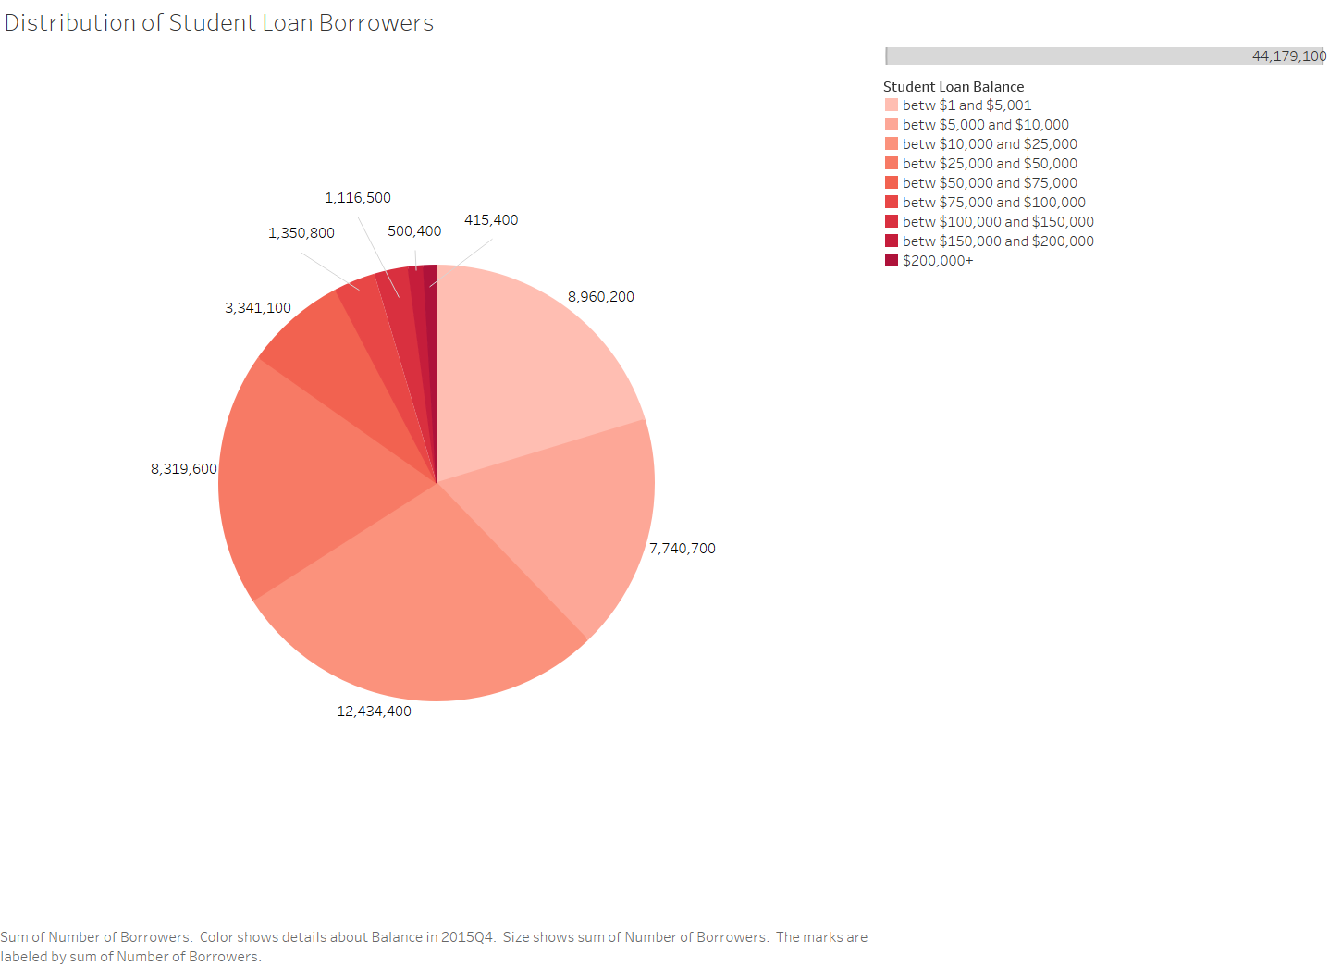
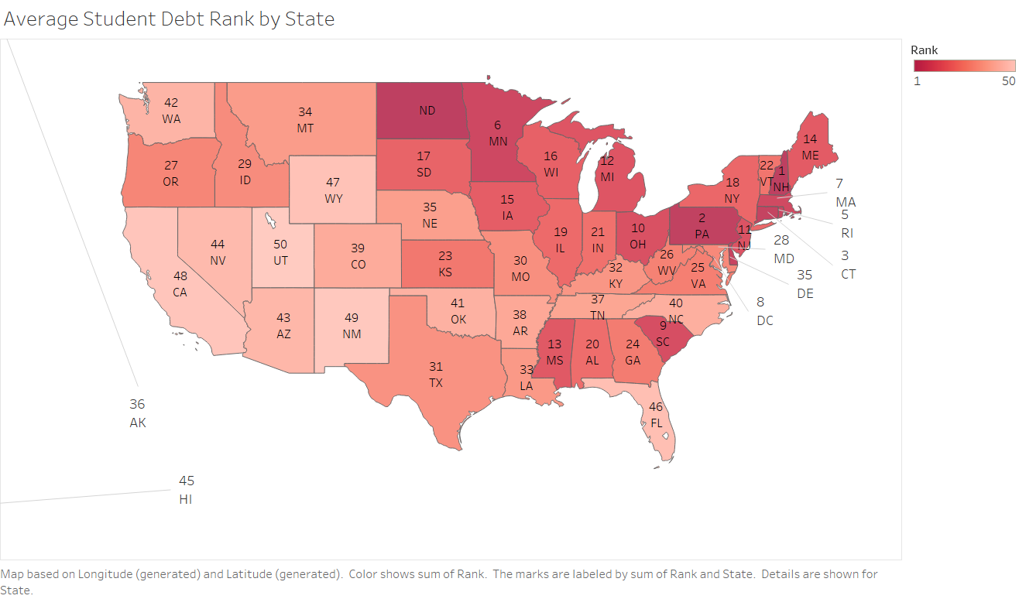
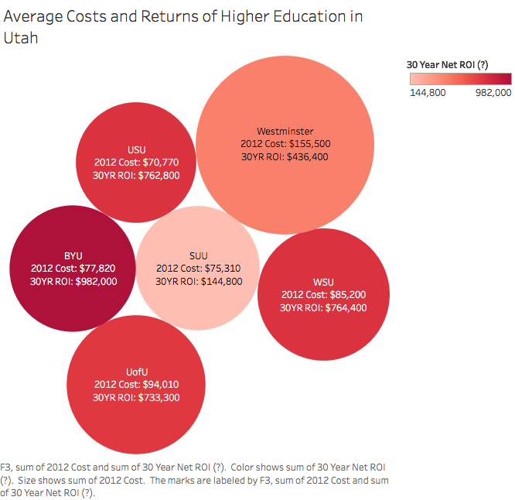
Preparing your poster for printing:
Go to File > Save As. Under Save as type (Windows) or Format (OS X), select PDF.
Open the PDF in Adobe Photoshop. Go to File > Save As. Under Format, select JPEG or TIFF. Choose a location and file name for your file and click Save. Click OK on the default save settings.
DO NOT SAVE TO A JPEG OR TIFF FROM POWERPOINT!
The Case for Financial Literacy
“The financial preparedness of our nation's youth is essential to their well-being and of vital importance to our economic future.”
Ben Bernanke (Former Chairman of the Federal Reserve)
Ting Chen, Ken Mirci, Dan Orton, Kyle Simms, Vai Suliafu, & Bart Todd
Economics Department
The University of Utah
INTRODUCTION
RESULTS
Figure 1) There are roughly 12,434,400 student loan borrowers who owe between $10,000 and $25,000 dollars, representing the majority which is 28.1% of the total. 8,319,600 student loans borrowers owe between $25,000 and $50,000, which makes up 18.8% of the total. 7,740,700 borrowers owe between $5,000 and $10,000 dollars which is 17.5% of the total. Only 1.1% of borrowers owe more than $200,000 in student loan debt, representing the minority. 84.7% of student loan borrowers owe less than $50,000 dollars.
Figure 2) New Hampshire (NH) is the state with the highest average student debt; $36,101 for the average student who borrows. The state with the lowest average student debt is Utah (UT); $18,873 for the average student who borrows. Eastern and northeastern states tend to have the highest average student debt rates, while western states tend to have the lowest.
Figure 3) The average cost for each listed institution ranges from $70,770 to $155,500 while the average 30 year ROI for each institution ranges from $144,800 to $982,000. $93,101.67 is the average cost for all the institutions while $637,283.34 is the average ROI. The average annual return of the combined institutions is around 6.62%.
Fast Facts
The cost of attendance for a bachelor’s (4 year) degree from the University of Utah costs approximately $100,000
The average debt for college graduates is $25,902 and the student loan debt ($1.2 trillion) embodied approximately 6% of the national debt ($20 trillion)
Among elderly Social Security beneficiaries, 48% of married couples and 71% of unmarried persons receive 50% or more of their income from Social Security
Furthermore, for elderly Social Security beneficiaries, 21% of married couples and about 43% of unmarried persons rely on Social Security for 90% or more of their income
Financial literacy is the ability to understand various topics in the area of finance
Some of these topics include:
Personal finance management
Investing
Planning for retirement
Paying for college
Budgeting
Making informed financial decisions
The Relevance of Financial Literacy
In today’s economy consumers are forced to navigate a complicated financial environment and financial mistakes can end up being very costly, especially when made at an early age
In 2003 Utah was ranked #1 in the nation in bankruptcy filings per capita which in turn spurred Senate Bill 154
Senate Bill 154 requires financial literacy instruction in the high school curriculum, along with graduation requirements
In 2004 the Utah Board of Education approved of a one-semester general financial literacy class that is required for graduating students, beginning with the class of 2008
Today there are only 22 states where a high school financial class is offered, and 7 states that have standardized testing of personal finance concepts (Utah is one of these seven states)
Utah’s financial literacy course is aimed to provide high school students with a springboard to college, along with giving them the tools they need for life-long financial success
CONCLUSIONS
The financial literacy course seems to be making progress towards its goals
Since the intervention of the mandatory financial literacy course, the bachelor’s degree graduation rate for Utah college students has increased around 6.38%
College is expensive and many students take out student loans in order to finance their education, however, the only thing more expensive than college is not going to college
The ROI on a college education is one of the best, if not the best, investment an individual can make for themselves
Utah is no longer ranked #1 in the nation in bankruptcy but it still has room for improvement
Pensions (defined contribution plans) are being replaced by defined contribution plans which makes understanding financial literacy even more important for the average person
With the importance of understanding one’s finances in modern life, it seems as though a half year class in financial literacy is not enough
REFERENCES
Cochrane, Debbie. The Institute for College Access and Success. Oct. 2016. Web. <http://ticas.org/sites/default/files/pub_files/classof2015.pdf#overlay-context=posd/map-state-data>.
Council for Economic Education. 2016. Web. <http://councilforeconed.org/wp/wp-content/uploads/2016/02/sos-16-final.pdf>.
Graduation Rates. 2017. Web. <higheredutah.org/data/graduation-rates/>.
Lee, Donghoon. Federal Reserve Bank of New York, 28 Feb. 2013. Web. <https://www.newyorkfed.org/medialibrary/media/newsevents/mediaadvisory/2013/Lee022813.pdf>.
Payscale. 2016. Web. <http://www.payscale.com/college-roi/state/Utah>.
Social Security Administration. 2017. Web. <https://www.ssa.gov/news/press/factsheets/basicfact-alt.pdf>.
APPROACH
Figure 1) Shows the distribution of student loan debt in the United States. The pie chart is divided into nine slices that represent the balance of outstanding student loans, and how many borrowers are represented in each slice.
Figure 2) Shows the average student debt ranking by state. Number 1 represents the state with the highest average student loan debt, while number 50 represents the state with the lowest average student loan debt.
Figure 3) Represents the cost and return on investment from each listed institution (all institutions are within the State of Utah). The size of the bubble is the average cost of attendance while the shade of the bubble is the expected return.
*All figures were constructed via Tableau
ACKNOWLEDGEMENTS
The University of Utah Economics Department for the sponsorship
Dr. Richard Fowles for guiding a valuable economics emphasis
Kyle Rehn for his mentorship
Travis Cook of the Utah Board of Education for the opportunity to undertake this project
The Jump$tart Coalition for Personal Financial Literacy for getting the ball rolling

